Slide 1
The people who call my work 'abstract' are imbeciles; what they call 'abstract' is in fact the purest realism, the reality of which is not represented by external form but by the idea behind it, the essence of the work.
Create like a god, command like a king, work like a slave.

Slide 2
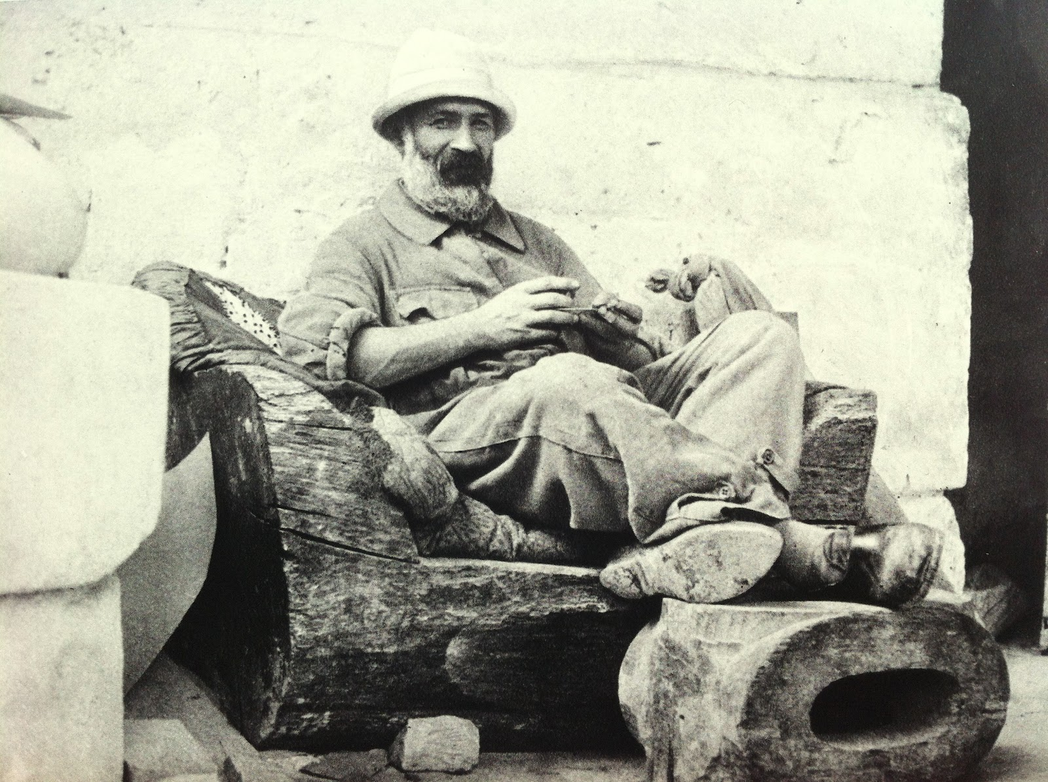
CONSTANTINE
BRANCUSI
1957

Slide 3
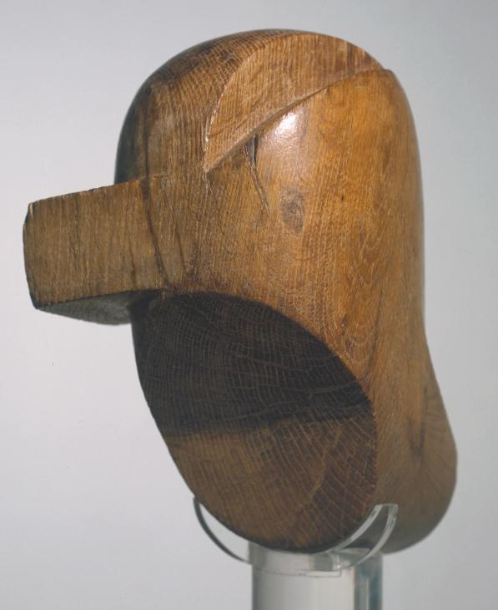
WHO IS HE?
Constantin Brancusi was a Romanian sculptor who is often regarded as the most important sculptor of the twentieth century. He was known for working directly with his materials.
He pioneered the technique of direct carving, rather than working with intermediaries such as plaster or clay models.
Head c.1919–23, MediumOak
DimensionsObject: 292 x 205 x 210 mm

Slide 4
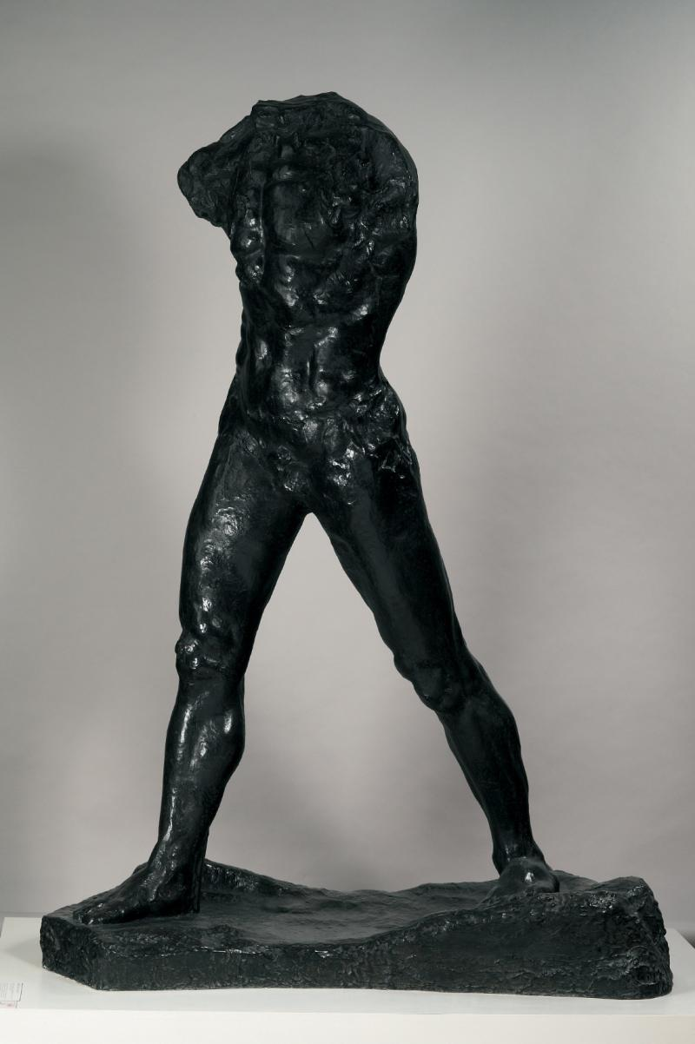
Influences?
François Auguste René Rodin was a French Sculptor who at the turn of the 19th to the 20th century, stood out from all the sculptors and broke all kinds of rules in terms of the way he handled surface, fragmented the human figure. Rodin's most original work departed from traditional themes of mythology and allegory, modeled the human body with realism, and celebrated individual character and physicality.
Rodin
He is interested in Romanian mythology Grew up near Targu Jiu (rich tradition of folk crafts, esp woodcarving) African, Mediterranean & Oriental art, Romanian Folkart.
Animals, particularly those with transformative powers in myths, were a source of fascination for Brancusi. He made numerous sculptures of fish, birds, seals, and swans.
1907
Bronze
H. 213.5 cm ; W. 71.7 cm ; D. 156.5 cm
S.998

Slide 5
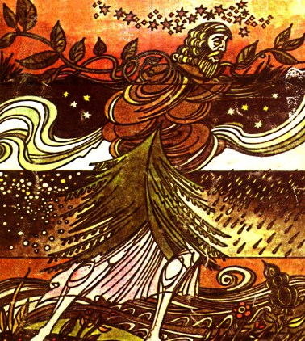
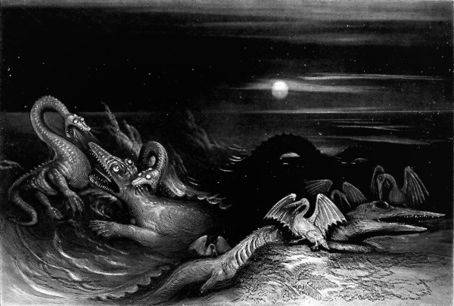
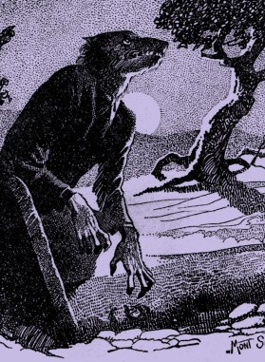
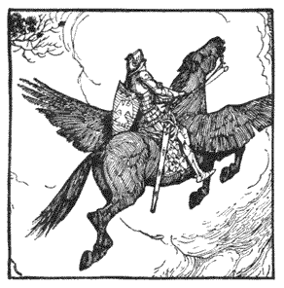
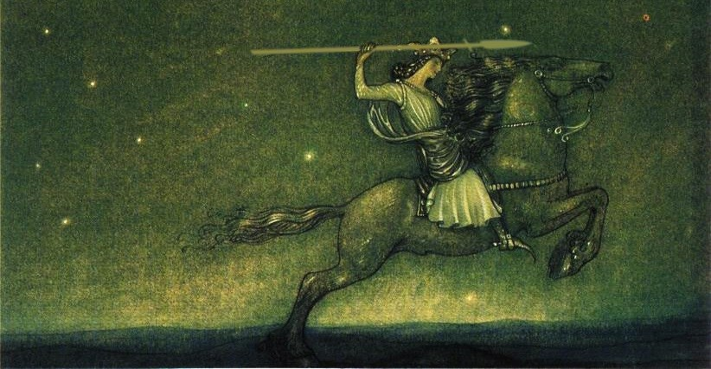
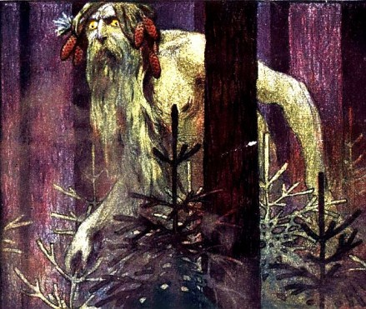

Slide 6
WORKING METHODS
Direct carving and not modelling like the way Rodin does
Worldview: essence over appearance
He considers the appearance ephemeral.
He chooses materials that can last for a long time like the traditional sculptural materials of marble, stone and bronze.
He returns to, reworks and re-interprets the same subject matter so that he can arrive closer to the essence of the subject matter.
His simplification methods are derived from being true to materials
He uses the natural qualities, cultural and cross-cultural meaning of materials as part of the meaning of his work.
The development of abstraction
He uses geometric lines
reduces representational forms into a simple composite of biomorphic/organic and geometric forms that can almost function as three-dimensional symbols.

Slide 7
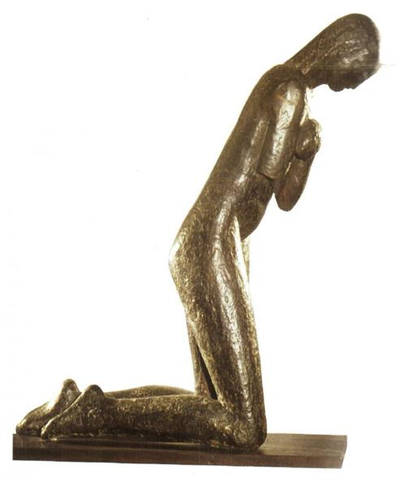
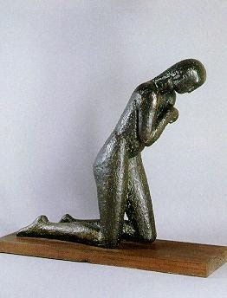
The prayer depicts a young woman crossing herself as she kneels. It is one of the first known attempts by Brancusi to introduce abstraction into his work.
"The Prayer" (1907)

Slide 8
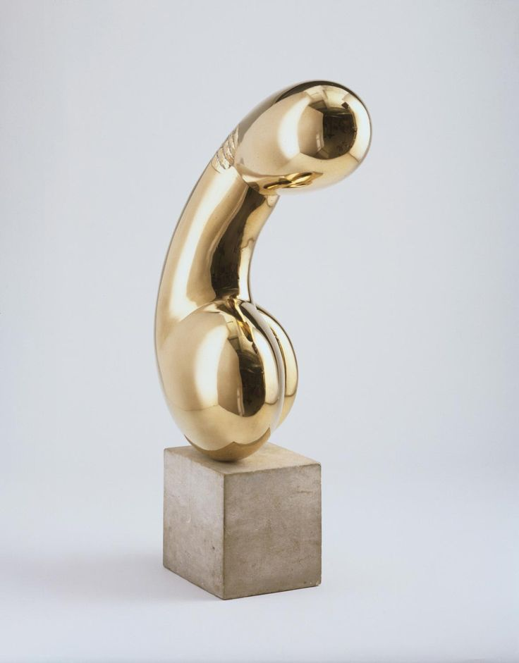
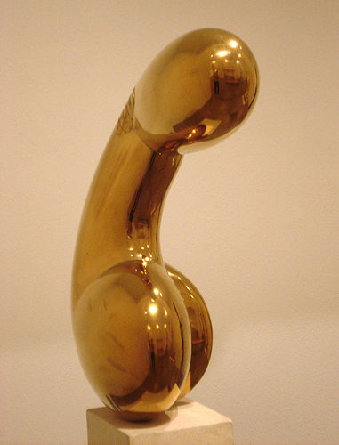
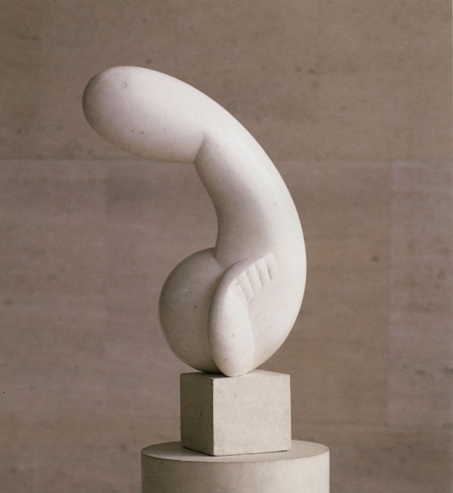
"Princess X" (1915-1916), Polished bronze; limestone block
What do you see?
Why do you think the sculpture is called ‘Princess X’?

Slide 9
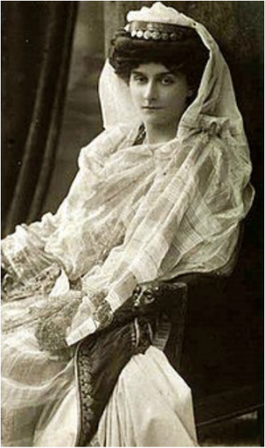
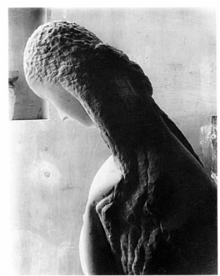
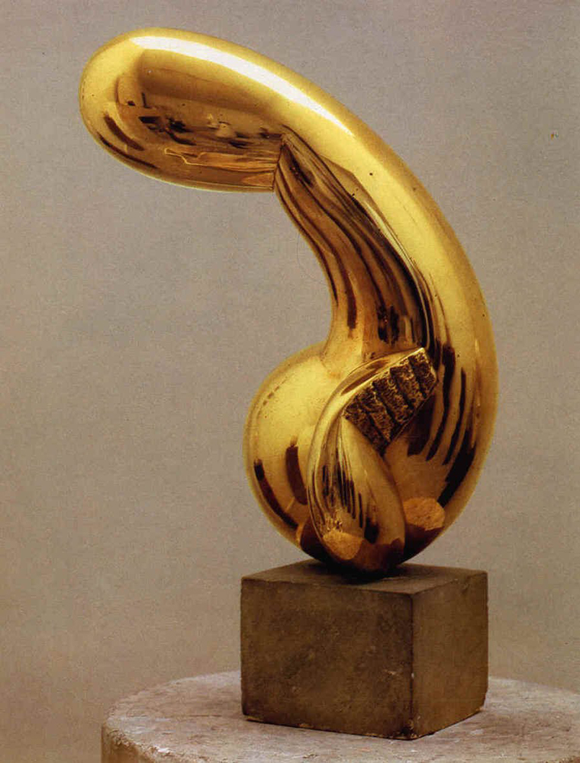
Princess X is a sculptured rendering of the French princess, Marie Bonaparte, by the artist Constantin Brâncuși.
Apparently, she was so vain that, while posing for him, she kept a small mirror nearby and kept glancing at it from time to time.

Slide 10
The work had been shown before, at the Society of Independent Artists in New York, without significant incident (In fact, it had been completely eclipsed there by the sensation surrounding the urinal in Marcel Duchamp’s Fountain) . But in Paris, it happened that one very famous visitor – accounts differ as to whether it was Picasso or Matisse – drew attention to it by exclaiming, “Here it is: the phallus!”

Slide 11
“My statue is of woman, all women rolled into one, Goethe’s Eternal Feminine reduced to its essence … For five years I worked, I simplified, I made the material speak out and state the inexpressible. For indeed, what exactly is a woman? Buttons and bows, with a smile on her lips and paint on her cheeks…That’s not woman. To express that entity, to bring back to the world of the senses that eternal type of ephemeral forms, I spent five years simplifying, honing my work. And at last I have, I believe, emerged triumphant and transcended the material. Besides, it is such a pity to spoil a beautiful by digging out little holes for hair, eyes, ears. And my material is so beautiful, with its sinuous lines that shine like pure gold and sum up in a single archetype all the female effigies on Earth.
What does this tell you about how Brancusi saw his work?

Slide 12
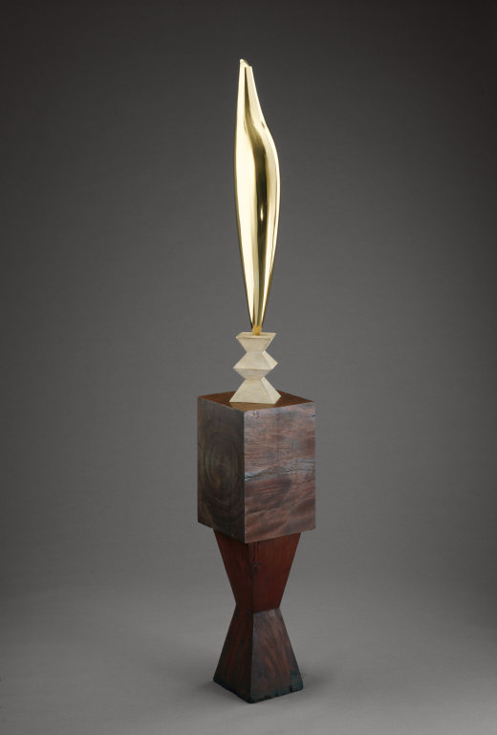
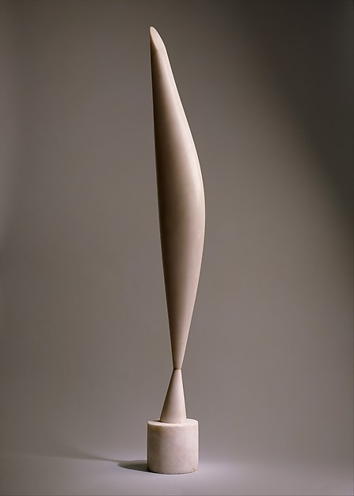
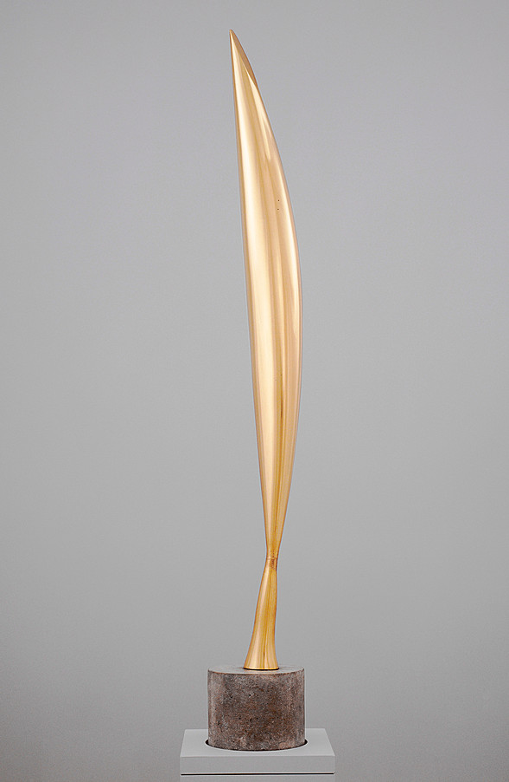
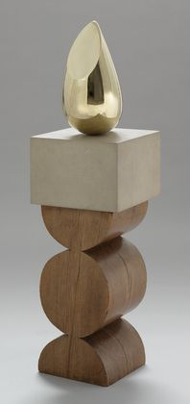
Bird in Space, 1923
Bird in Space (1928)
Young Bird. Paris 1928
Birds in Space is a series of sculptures was created by Brancusi, dating from 1923 to 1940. The series of work focuses on his preoccupation with a bird in flight. The materials of other pieces are marble and bronze cast.
Golden Bird, 1919/20 (base c. 1922)

Slide 13
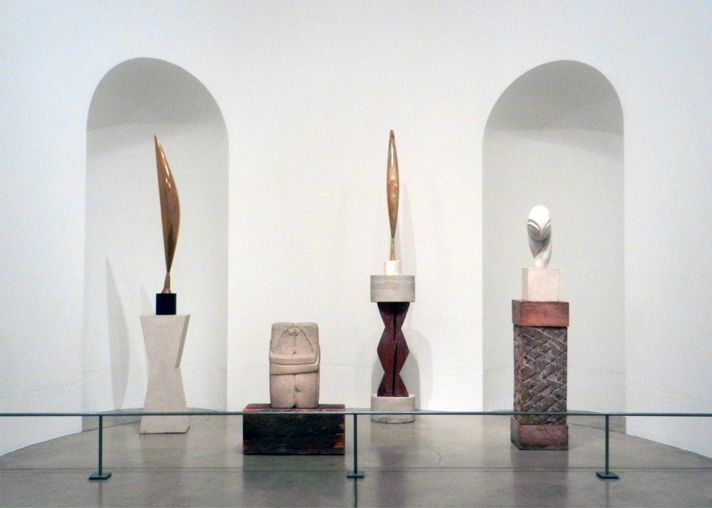

Slide 14
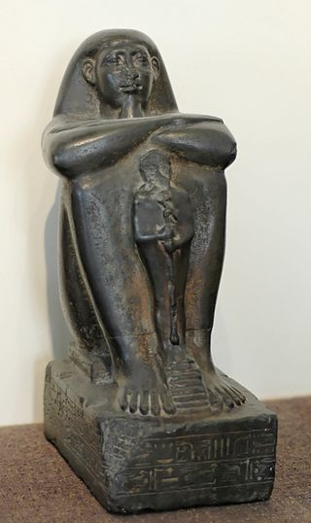
THE BASE
Where/What is the base?
Why do you think the work is presented in such a way?
Block statue of Pa-Ankh-Ra, ship master, bearing a statue of Ptah. Late Period, ca. 650–633 BC, Cabinet des Médailles.
Young Bird. Paris 1928

Slide 15
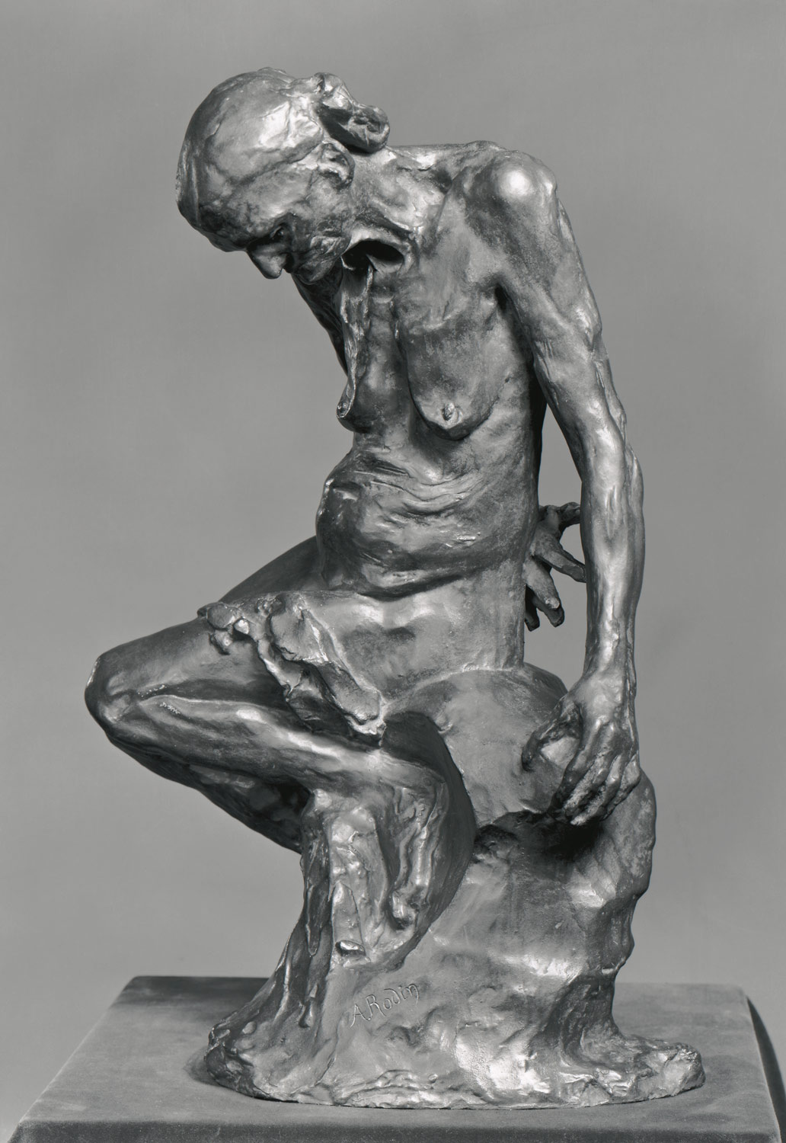
The role of the base
The role of the base is physical, visual and symbolic. Physical: support.
Visual: presenting the object at proper level.
Symbolic: positioning the object's relation with the world.
The base may not be considered as a work of art. Still, it must be carefully designed because of its supporting role.
Usually it is a wooden pedestal or a stone pedestal, he identified a hierarchy of materials. Wood < stone < metal. From primitive to industrial.
The Old Courtesan modeled probably ca. 1885, cast 1910
Young Bird. Paris 1928

Slide 16
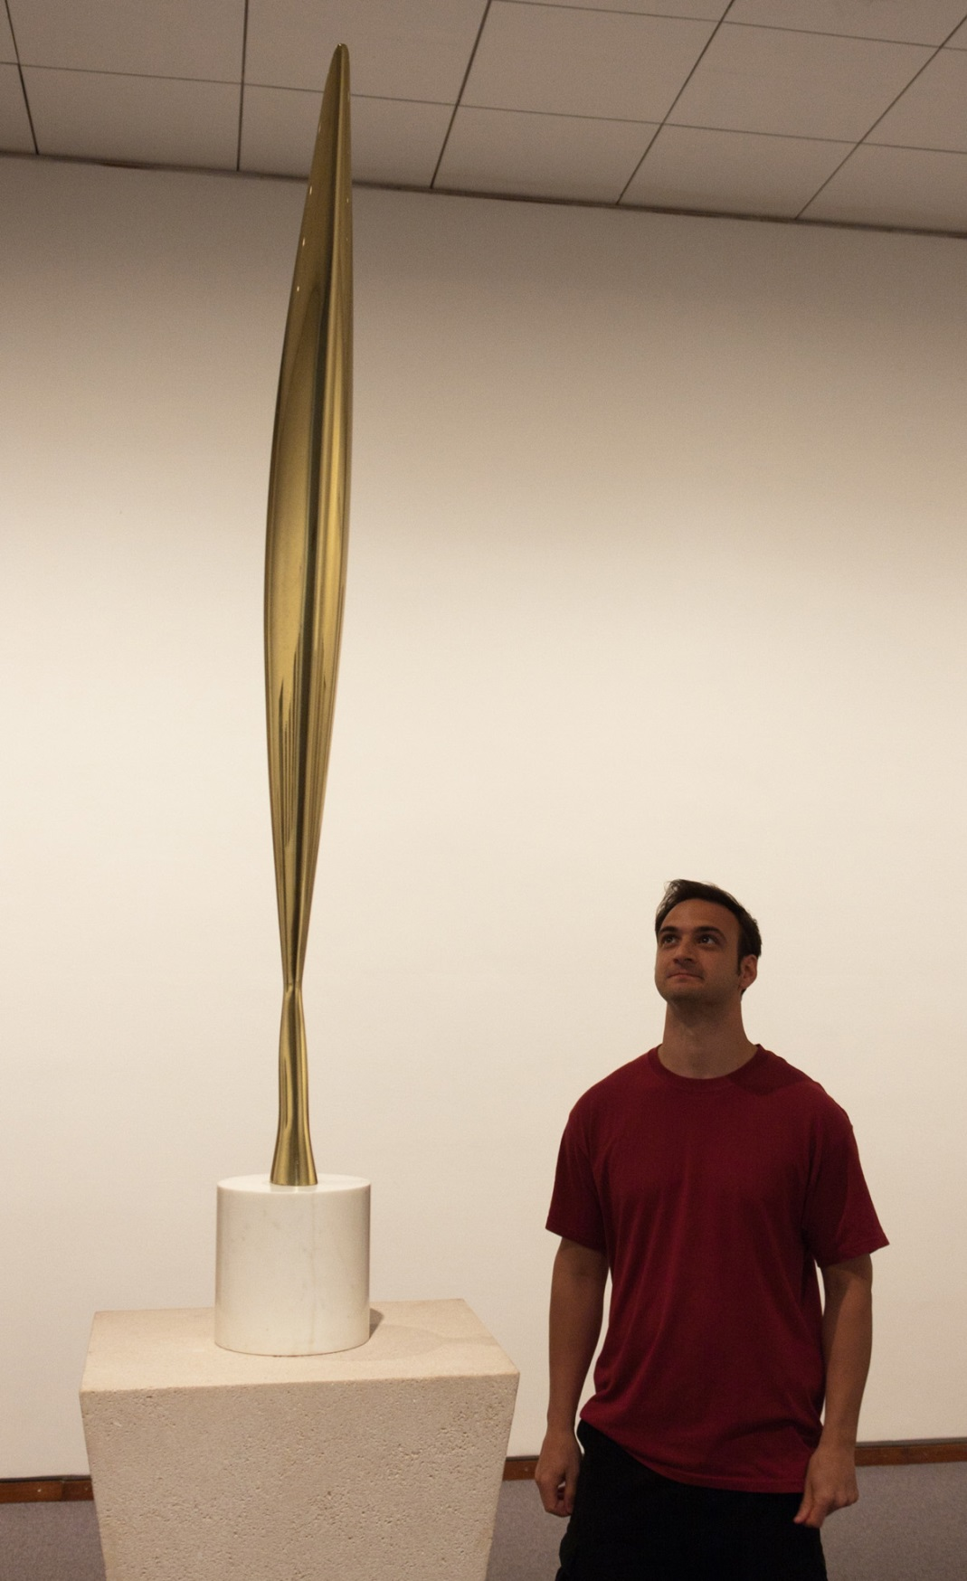
New York A Customs appraiser, F J H Kracke, was presented with an unusual, highly polished object made of bronze, whose status had earlier been questioned by customs officials.
After consultation, Kracke classified it as a “manufactured implement” and imposed the normal 40% customs duty applicable to metallic household utensils.
Kracke, on the other hand, relied on the opinions of “several men, high in the art world”; typical among these was one who stated, “if that’s art, hereafter I’m a bricklayer.” In general their opinion was that Brancusi’s work “left too much to the imagination”.
Bird in Space, 1932–40, 56 3/4 x 6 1/2 in. (144.1 x 16.5 cm) (with base), Marble,

Slide 17
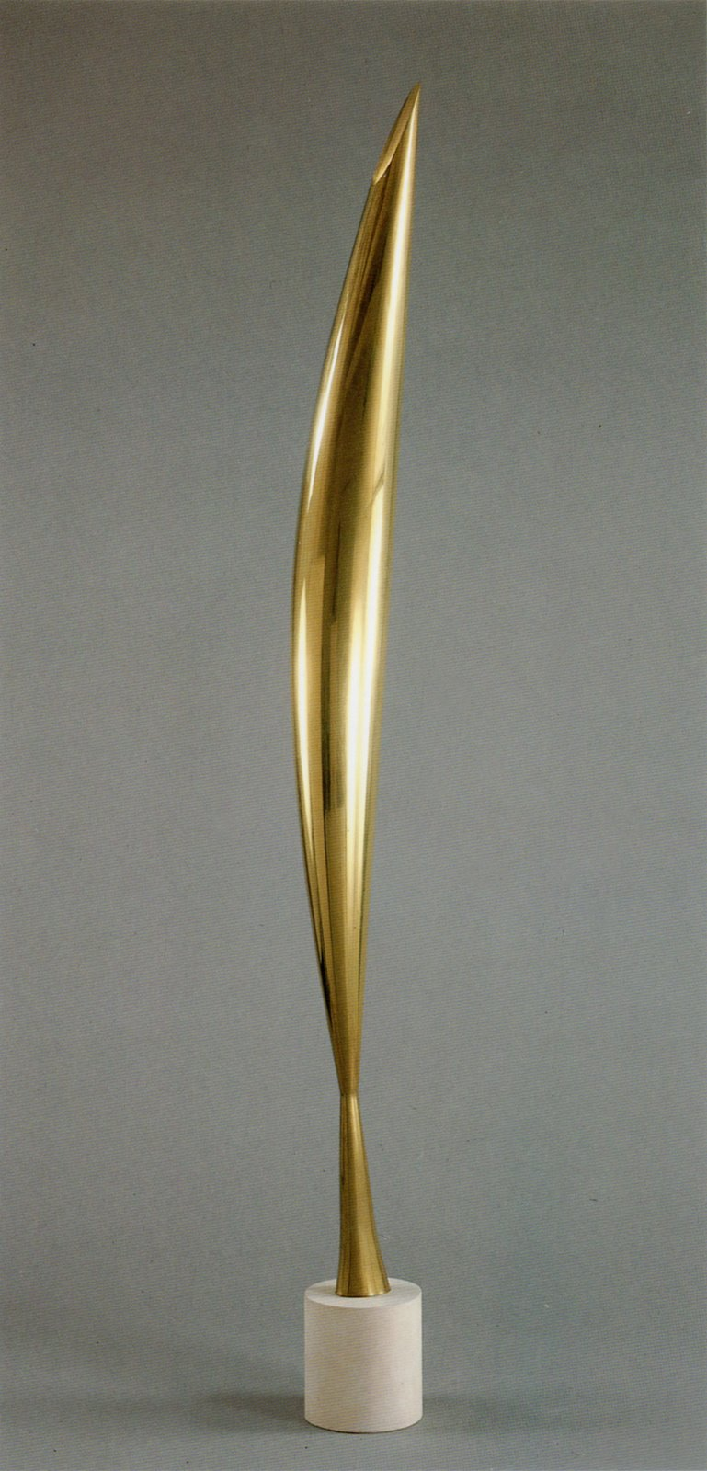
How has the subject matter been interpreted in this sculpture?
https://www.khanacademy.org/humanities/art-1010/art-between-wars/intl-avant-garde/v/brancusi-bird-in-space-1928
Bird in Space, 1932–40, Polished brass, 59 7/16 inches (151 cm) high, including base

Slide 18
Bird in Space
Single simple shape
Pure tapering form
Highly polished and smooth metallic, continuous surface
Carved from individual piece of bronze
Infer how these qualities contributed to the resultant visual impact of the sculpture: smooth, reflective look to the sculpture, etc
Bird in Space, 1932–40, Polished brass, 59 7/16 inches (151 cm) high, including base

Slide 19
Exploring the concept of flight in birds
Demonstrating the dynamic upward thrust
Feeling and idea are reduced to a single, simple shape
Expressing its slenderness and weightlessness
Though appeared to have reduced the bird’s recognizable parts to a simple shape, it is not the abstract image of a bird but flight itself – made visible and concrete
Bird in Space, 1932–40, Polished brass, 59 7/16 inches (151 cm) high, including base

Slide 20
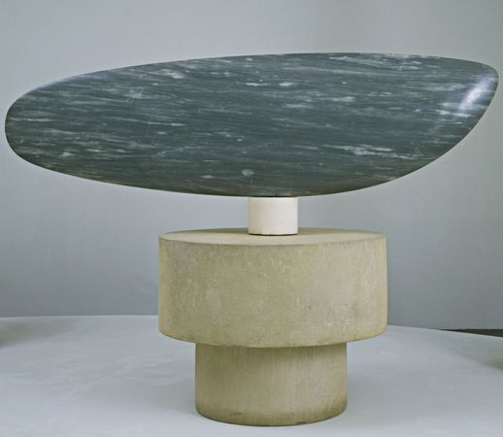
He suppressed all decoration and explicit narrative referents in an effort to create pure and resonant forms.
His goal was to capture the essence of his subjects—which included birds in flight, fish, penguins, and a kissing couple—and render them visible with minimal formal means.
What value did he see in reducing the forms of his subject matter?
Constantin Brancusi. Fish. Paris 1930. Blue-gray marble 21 x 71 x 5 1/2" (53.3 x 180.3 x 14 cm), on three-part pedestal of one marble 5 1/8" (13 cm) high, and two limestone cylinders 13" (33 cm) high and 11" (27.9 cm) high x 32 1/8" (81.5 cm)

Slide 21
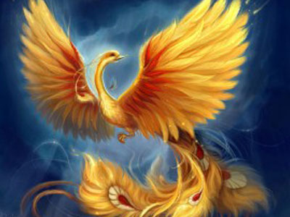
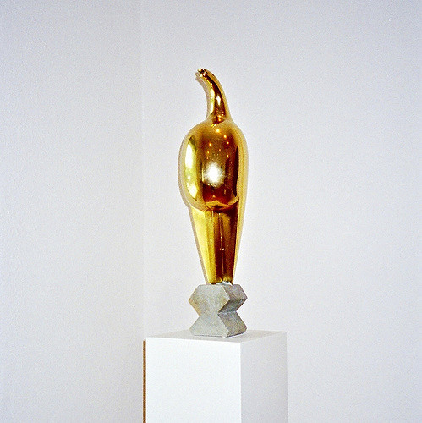
In reducing animals to elemental shapes, he felt he was approaching the essence of nature. Also, like a number of European artists of his period, he was excited by art from outside the classical tradition so influential in Western aesthetics.
Constantin Brancusi: Maiastra
1912-1913

Slide 22
1930s
Brancusi became interested in mysticism and spirituality, particularly in the writings of the Tibetan, Milarepa.
This influenced his work,
Monumental Ensemble at Tirgu Jiu, 1937.

Slide 23
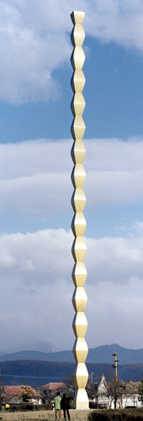
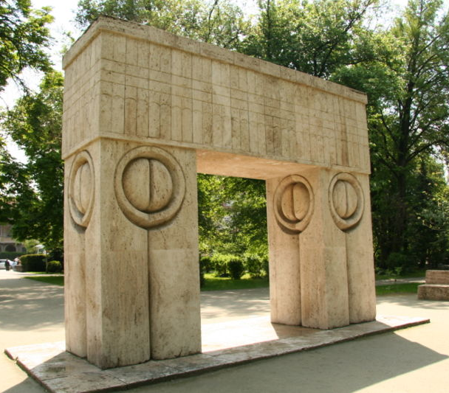
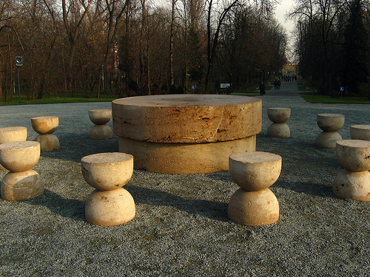
Monumental Ensemble at Targu Jiu, 1937
In 1938, Brancusi finished the World War I monument in Târgu-Jiu where he had spent much of his childhood.
The ensemble commemorates the courage and sacrifice of Romanian war heroes who fell defending the banks of the Jiu River in 1916 while fighting off a German invasion.
Endless Column (30-m high zinc and brass clad, cast-iron modules)
The Gate of Kiss (limestone monument)
The Table of Silence (limestone monument)

Slide 24
of the
monumental ensemble at Tirgu Jiu
River Jiu
160m
1493m

Slide 25
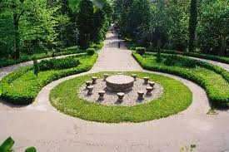
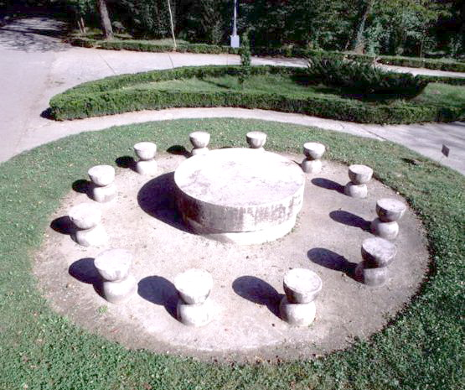
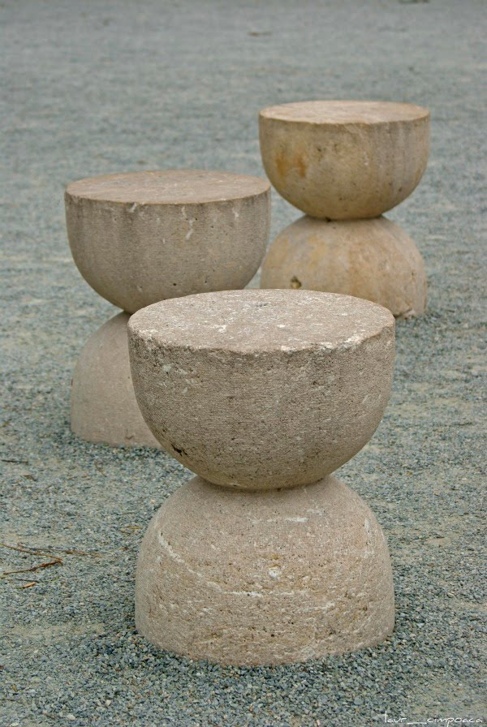
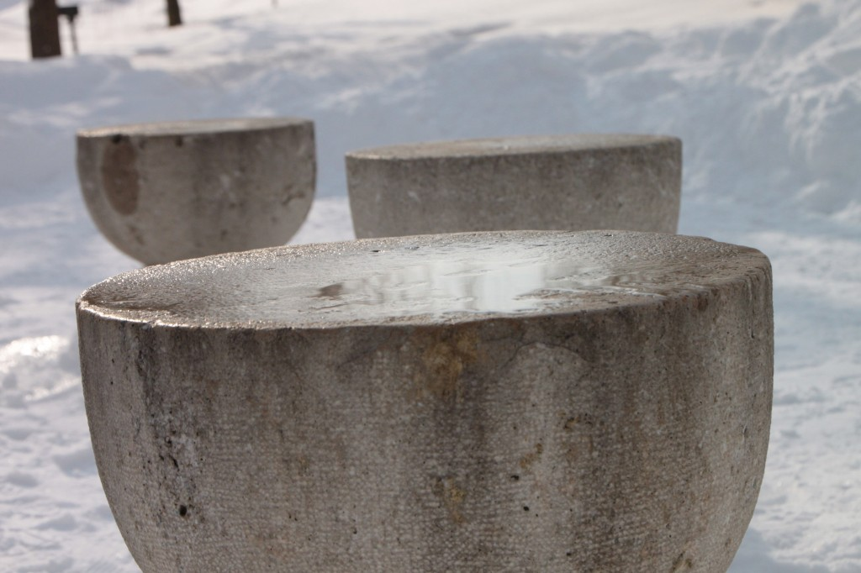
The Table of Silence
Description:
Made of limestone
Table was made up of 2 massive, cylindrical stone slabs, one on top of the other.
The diameter of the upper slab is 215 cm and 45 cm thick.
The lower slab is 200 cm and 40 cm thick.
12 stone seats surround the table, each has a diameter of 45 cm and is 55 cm high.

Slide 26
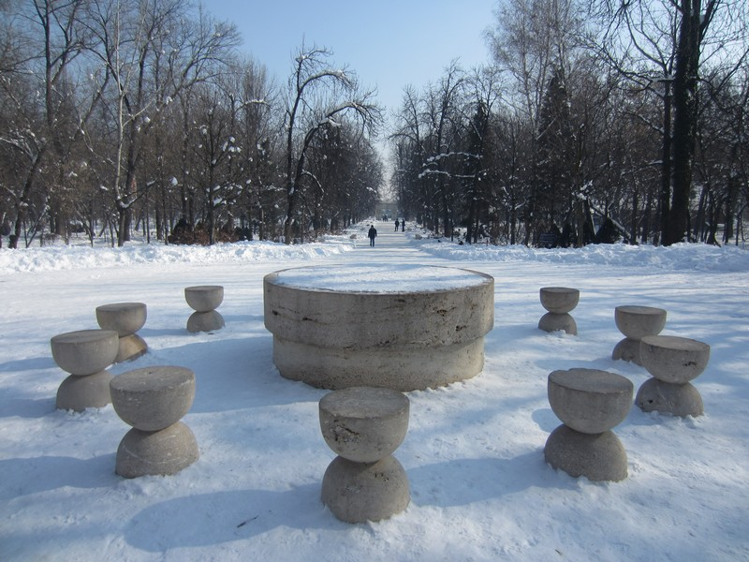
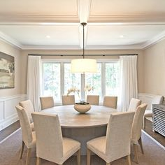
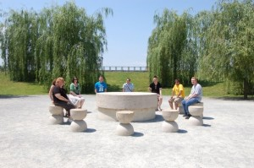
The Table of Silence
What is the function of a dinner table?
Why do you think the artist called the work “Table of silence?”
As Brancusi explained, it represents the unity of a family gathered to "dine and rest" .
By extension, the Table implies communal interchange, praising the townspeople who rallied to fight off the enemy.
The emptiness of this "base" mirrors the emptiness left in the community by the deaths of its heroes during the war.
Just as its title, Table of Silence, points to an absence of sound, the Table also points to the absence of the people whose death it commemorates.

Slide 27
The Table of Silence
The Table of Silence represents the table around which gather the soldiers before confronting their enemy.
At the same time, the 12 chairs stand in silence for the time disposed in hourglasses.
There are also 12 chairs, each chair representing each hour. Therefore, the seats symbolize time, this is indicated by the way the artist crafted the chairs (Hourglass).
Some make an analogy with The Last Supper since the monument has 12 seats (representing the apostles) and the table in the middle, Jesus Christ.
It may also signify the experience of spiritual recollection and imagined spiritual communion.

Slide 28
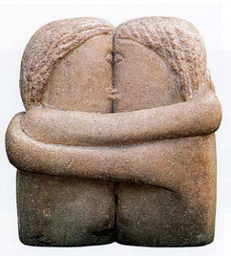
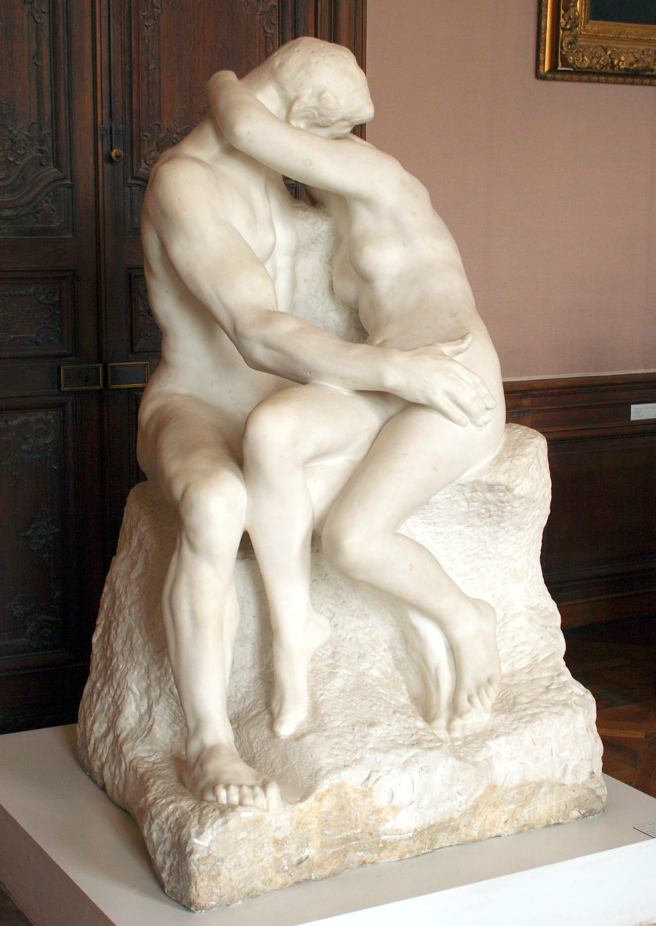
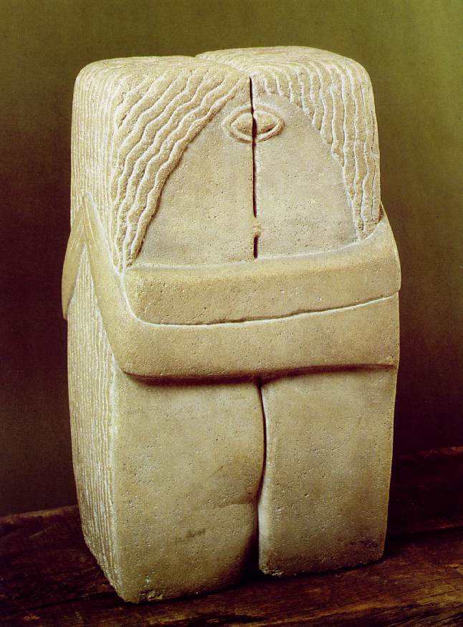
The Kiss, 1907
The Kiss
1916. 58.4 x 33.7 x 25.4 cm
Brancusi's first version of The Kiss, created in 1907, marked a major departure from the emotive realism of Rodin's famous handling of the same subject.
This 1916 version is the most geometric of Brancusi's series, reflecting the influence of Cubism in its sharply defined corners.
The embracing couple are schematic figures, acting as a sign of ideal union. The woman and man are almost, though not quite, indistinguishable
Auguste Rodin, The Kiss, 1882. Marble, 181.5 × 112.5 × 117 cm

Slide 29
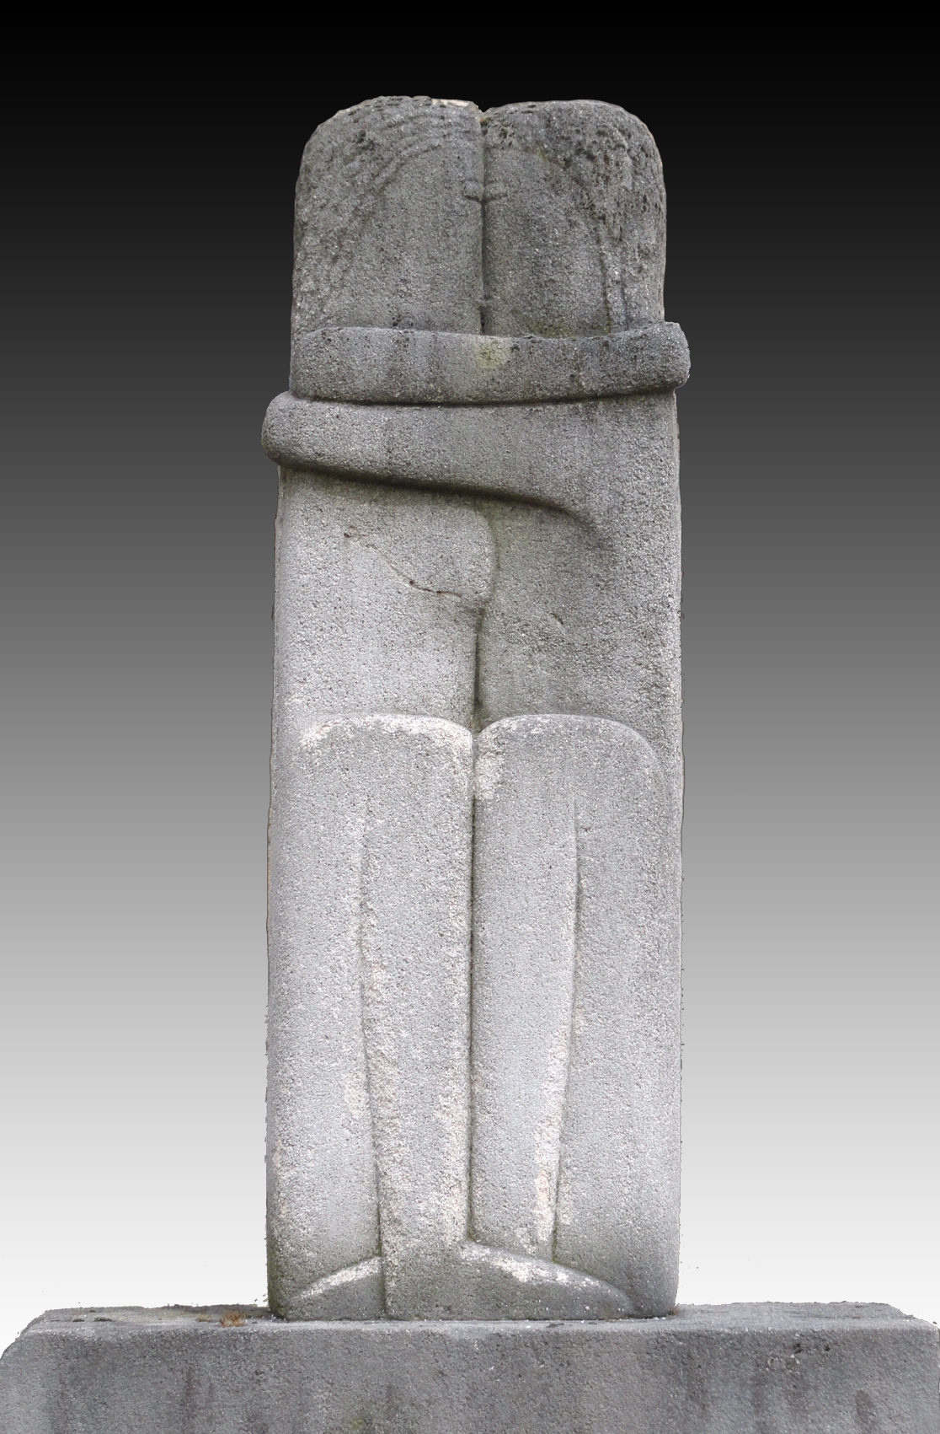
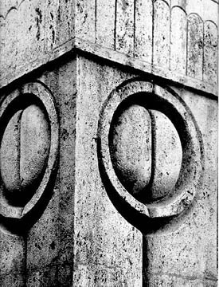
The Kiss presents a symbolic rendering of a male and a female body merging into one.
The anatomical forms of the couple are subordinated to the contours of the block of stone.
The sculpture went through direct carving. It was not carved or modelled like Rodin’s work.
The Kiss, 1907
The Gate of Kiss (limestone monument)
The Kiss, 1909, 89.5 x 30 x 20 cm, stone
Detail from The Gate of Kiss
The Kiss
1916. 58.4 x 33.7 x 25.4 cm

Slide 30
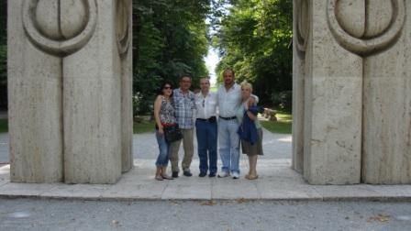
The Gate of Kiss
Made of Banpotoc travertine stone, a type of limestone.
The posts and lintel are of soft, warm ivory tone.
Dimensions: 5,13 m high, 5,45 m long and the posts have 1,69 m width.
The same motif, abstract to the point of a hieroglyph, reappears in still more stylized form on the upper part of all 4 sides of each of the supporting pillars.
Brancusi was inspired by Romanian traditions. The Romanians gates are incised with protective devices as each gateway marks a passage from an impure place to a better place.
The Gate of Kiss, 1938.
Banpotoc travertine stone (limestone) monument.

Slide 31
The Gate of Kiss (Meaning)
The Gate of the Kiss makes the transition to another life, symbolizing the triumph of life over death.
The second meaning of the gate: the kiss means union of the eight columns /regions that was attached to the mother country, Romania.
The Kiss symbol incised and carved onto the Gate act as a symbol of the fusion of opposites, a union that transcends sexuality. This fusion and transcendence are expressed with male and female as equal halves of the whole
The Gate of Kiss is done in response to Rodin’s Gates of Hell. At the same time, the egg-like circle formed by the pair of eyes suggests the cycle of procreation.
The Gate of Kiss, 1938.
Limestone monument.

Slide 32
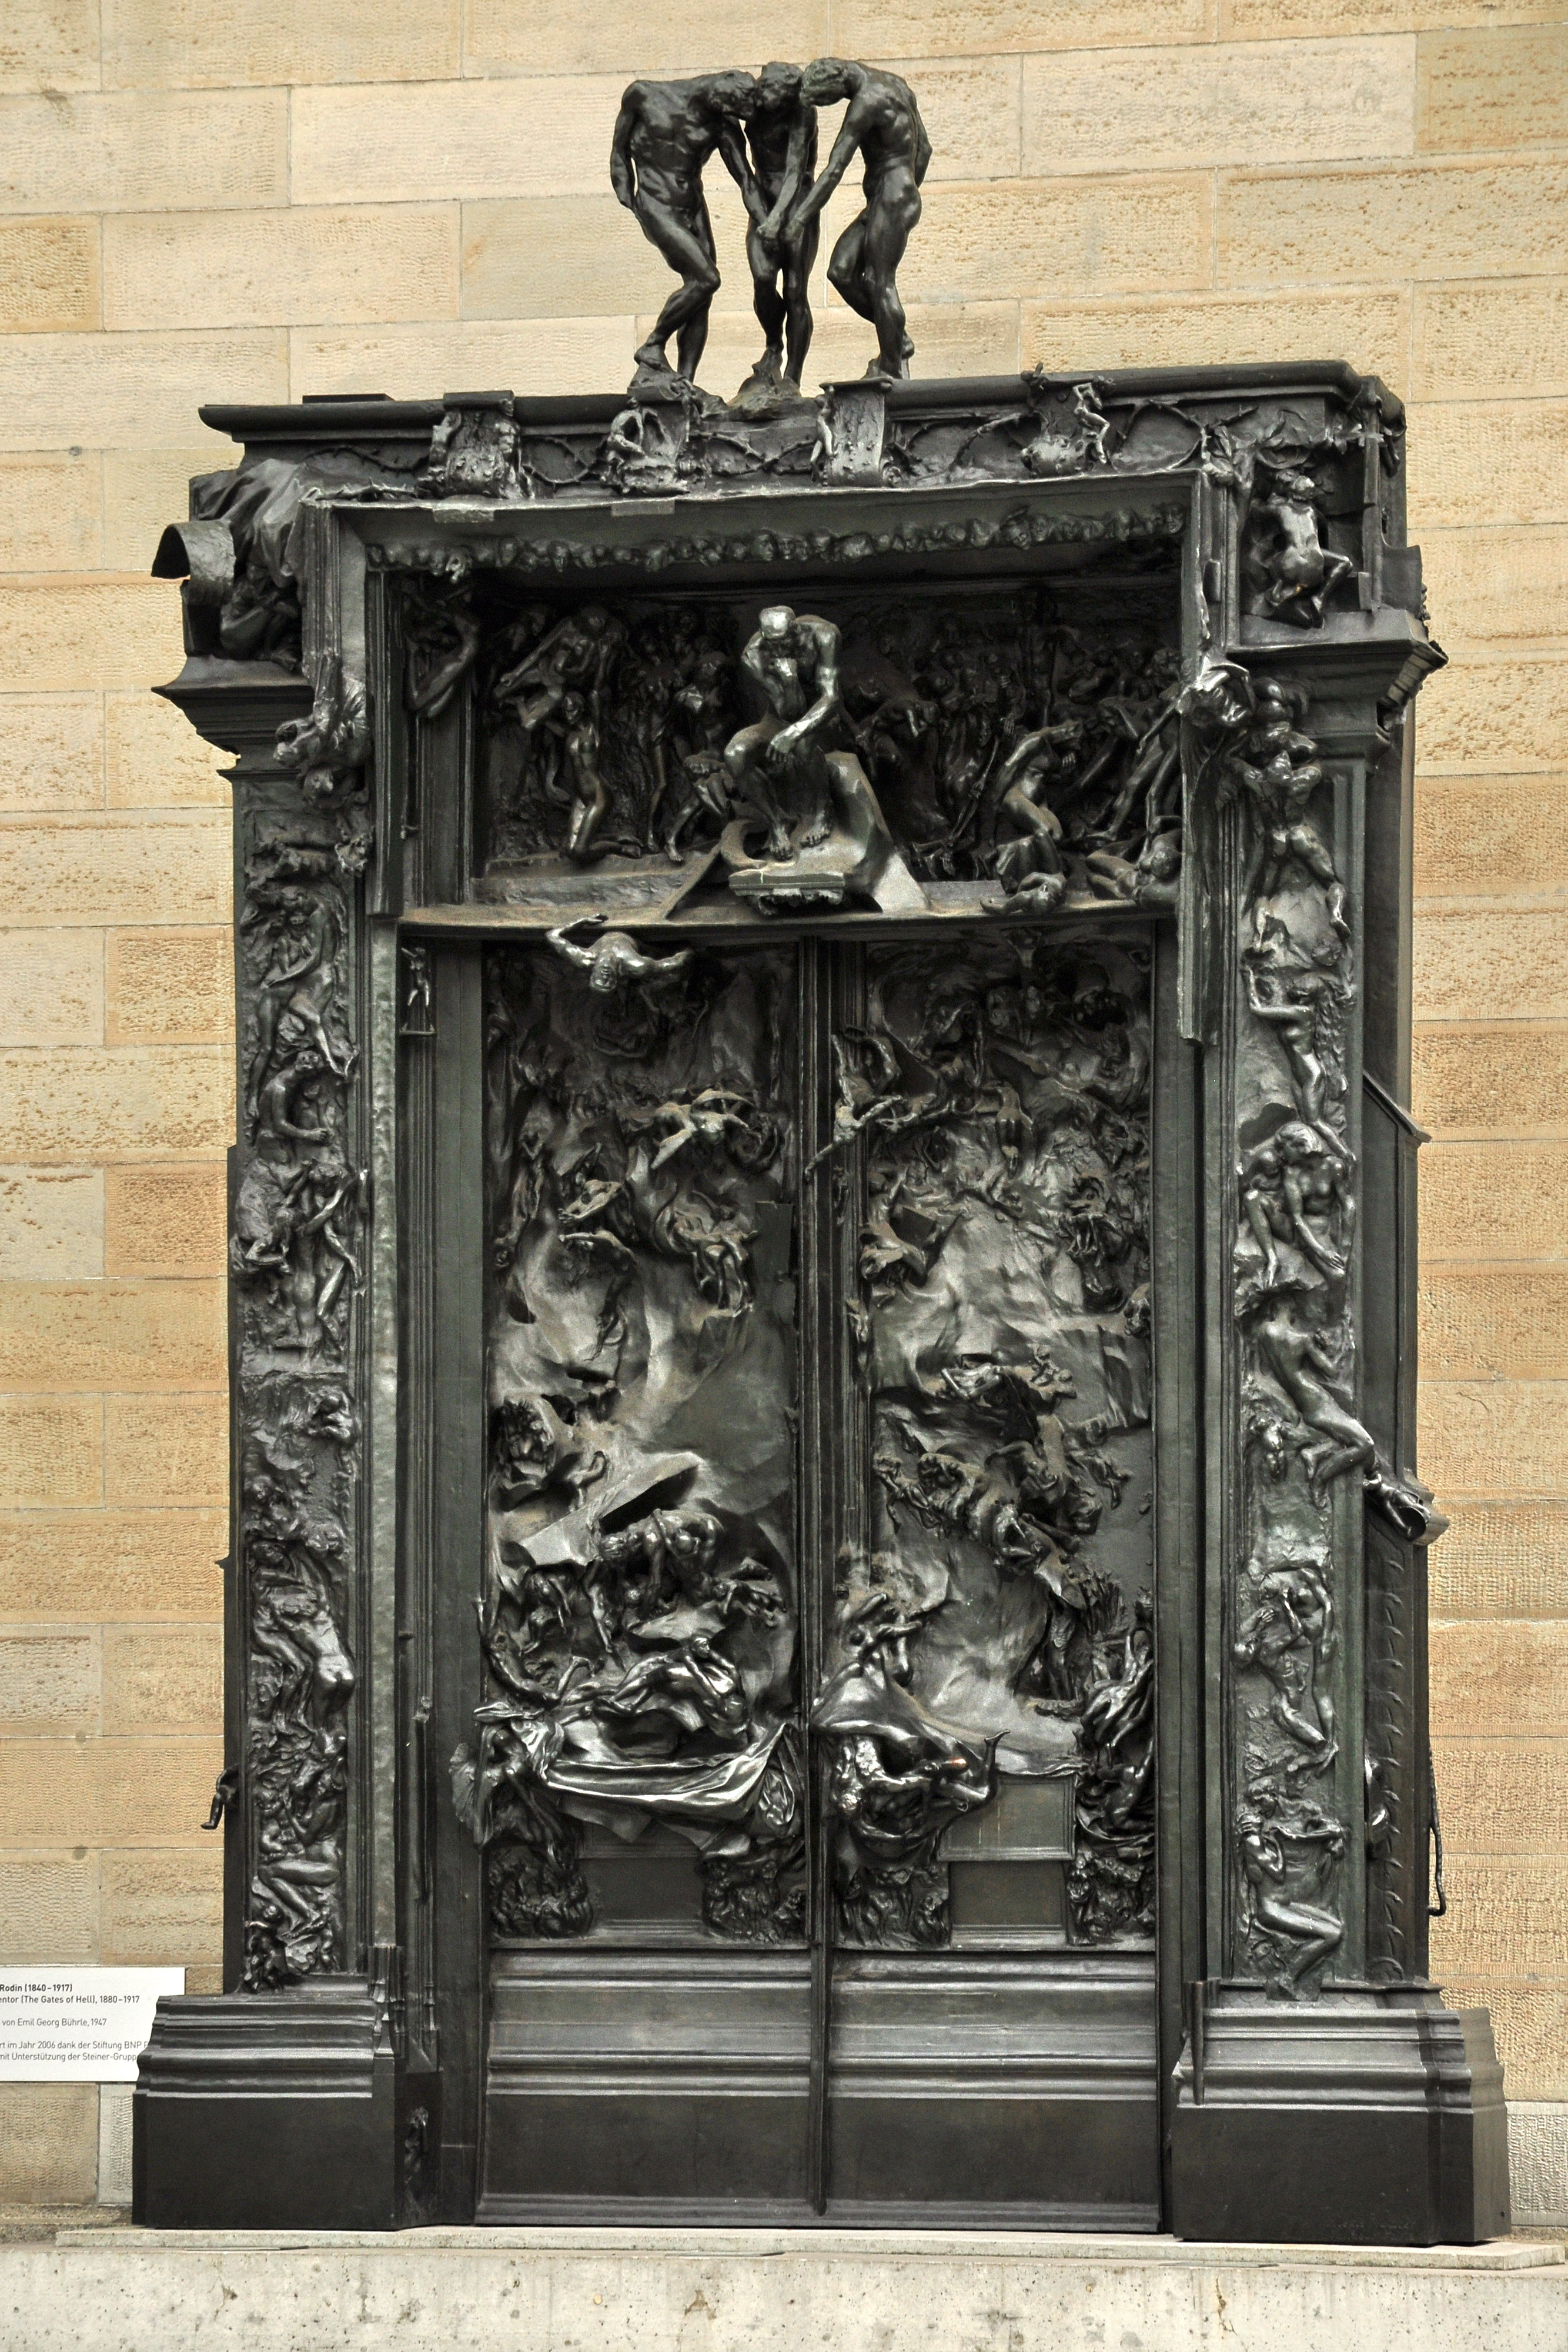
Rodin, Gate of Hell,
1880-1917.
Bronze, 6 x 4 x 1 m

Slide 33
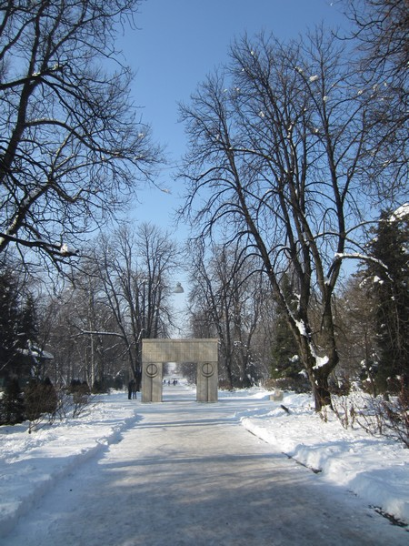
http://littleaesthete.com/brancusi-art-in-targu-jiu/

Slide 34
Endless Column

Slide 35
Endless Column
Description:
About 30-m high
15 full square-cross-sectioned rhomboidal zinc and brass coated cast-iron modules + 2 half modules (Altogether 17)
Each module has 45 cm-sided squares at its widest, 1.8m high (height of a person) and about 860 kg in weight
The incomplete top and bottom unit is thought to be the element that expresses the concept of the infinite.
At the base it is fixed into an impressing circular pedestal covered with ground.

Slide 36
Endless Column
In the Tîrgu-Jiu region, when a person dies it is customary to cut down a fir tree and plant it at the head of the grave, so that the tree may "weep" for the deceased as it sheds its needles onto the grave below.
The column is thus a stylized fir tree and a symbol of death. At the same time, Brancusi intended it as a "stairway to heaven." Indeed, everything about it suggests an upward movement and a "cosmic endlessness" transcending both gravity and mortality.

Slide 37
Endless Column
As it has no beginning or end. It represents the Column of the infinite sacrifice of the Romanian heroes for the reunion of the nation
The conclusion which represents the flight to the hidden heart of cosmic space.
Brancusi intends for the viewer of Endless Column to feel like an atom when standing next to it.
It is too large to be grasped. And it has to be seen from a distance. This may make its viewer feel that it is unreal and mythical, something he/she cannot relate directly and intimately with.
Flight to the hidden heart of cosmic space

Slide 38
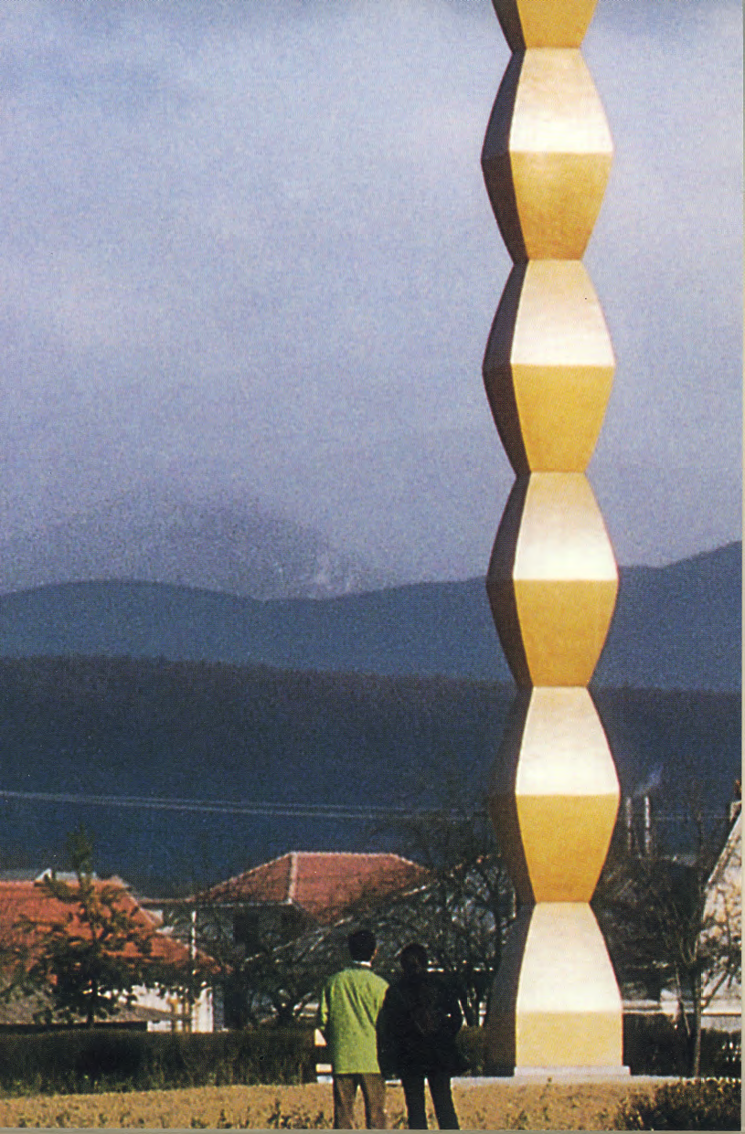
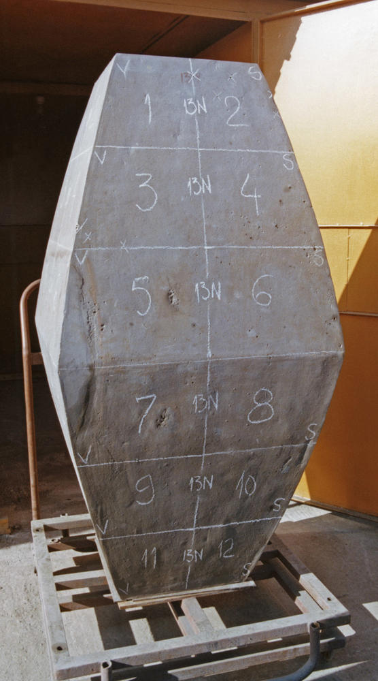
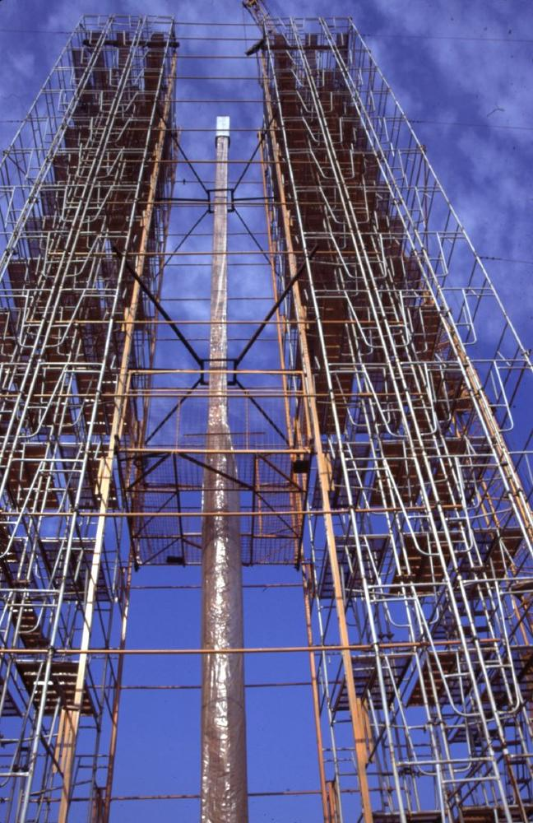
Hailed as one of the great works of twentieth-century sculpture, Endless Column by Constantin Brancusi (1876-1957).

Slide 39
Helvetica
https://www.youtube.com/watch?v=7JkpYgjbYRg

